Slide 1
Computational Thinking & Systems Design Stack-based VM
Ben Koo
October 27, 2020

Slide 2
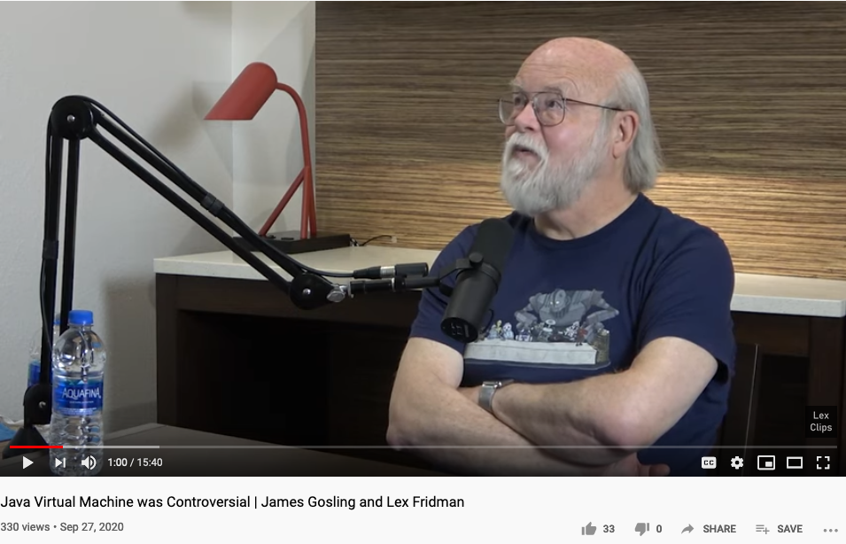
Java Virtual Machine

Slide 3
Where we are at:
Human
Abstract design
Software
Thought
abstract interface
hierarchy
Chapters 9, 12
H.L. Language
Compiler
&
abstract interface
Operating Sys.
Chapters 10 - 11
Virtual
VM Translator
Machine
abstract interface
Chapters 7 - 8
Assembly
Language
Assembler
Chapter 6
abstract interface
Computer
Machine
Architecture
Language
abstract interface
Chapters 4 - 5
Gate Logic
Hardware
abstract interface
Platform
Chapters 1 - 3
Electrical
Hardware
Chips &
Engineering
Logic Gates
Physics
hierarchy

Slide 4
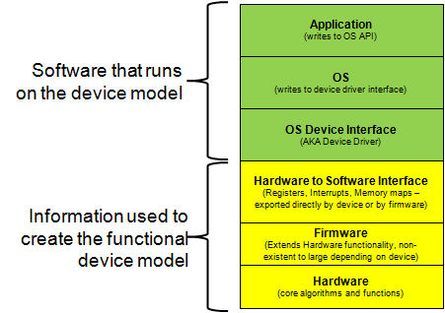
From Hardware to Software
Image Source: http://community.cadence.com/cadence_blogs_8/b/sd/archive/2012/06/26/dac2012-enabling-the-programming-of-an-extensible-processing-platform

Slide 5
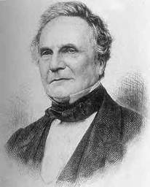
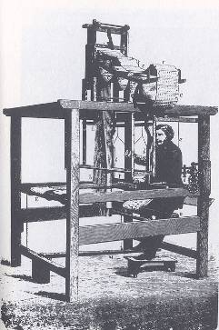
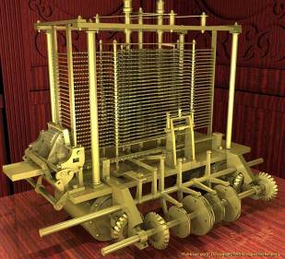
Babbage’s Analytical Engine (1835)
“We may say most aptly that the Analytical Engine weaves algebraic patterns just as the Jacquard-loom weaves flowers and leaves” (Ada Lovelace)
Charles Babbage (1791-1871)

Slide 6
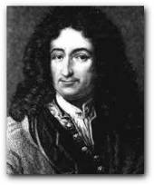

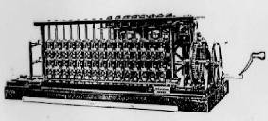
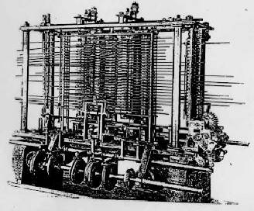
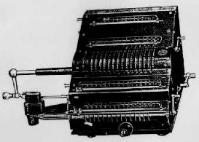
Some early computers and computer scientists
Blaise Pascal 1623-1662
Gottfried Leibniz 1646-1716

Slide 7

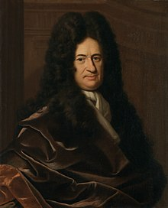
The monad, about which we shall speak here, is nothing other than a simple substance which enters into compounds, ‘simple’ meaning ‘without parts’. - Leibniz
Monad: Leibniz’s Universal Abstraction Unit

Slide 8
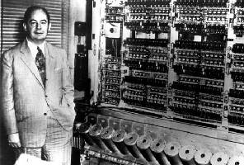

Von Neumann machine (circa 1940)
Stored program concept!
John Von Neumann (and others) ... made it possible
Andy Grove (and others) ... made it small and fast.

Slide 9
Screen memory map
In the Hack platform, the screen is implemented as an 8K 16-bit RAM chip.
How to set the (row,col) pixel of the screen to black or to white:
Low-level (machine language): Set the col%16 bit of the word found at Screen[row*32+col/16] to 1 or to 0 (col/16 is integer division)
High-level: Use the OS command drawPixel(row,col)
(effects the same operation, discussed later in the course, when we’ll write the OS).
Notes:
9

Slide 10
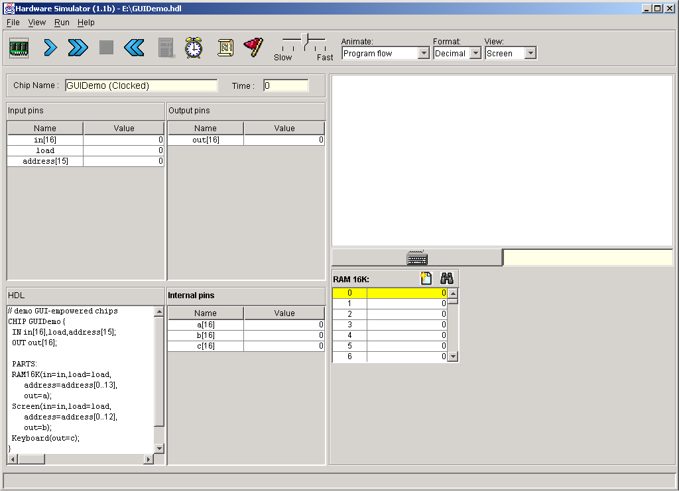
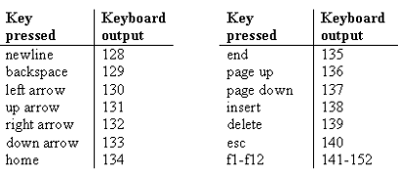
Keyboard
Simulated keyboard:
Keyboard chip: a single 16-bit register
Input: scan-code (16-bit value) of the currently pressed key, or 0 if no key is pressed
Output: same
The simulated keyboard enabler button
The keyboard is implemented as a built-in Keyboard.hdl chip. When this java chip is loaded into the simulator, it connects to the regular keyboard and pipes the scan-code of the currently pressed key to the keyboard memory map.
Special keys:
How to read the keyboard:
Low-level (hardware): probe the contents of the Keyboard chip
High-level: use the OS command keyPressed()
(effects the same operation, discussed later in the course, when we’ll write the OS).

Slide 11
Motivation
Jack code (example)
Hack code
class Main {
static int x;
function void main() {
// Inputs and multiplies two numbers
var int a, b, x;
let a = Keyboard.readInt(“Enter a number”);
let b = Keyboard.readInt(“Enter a number”);
let x = mult(a,b);
return;
}
}
// Multiplies two numbers.
function int mult(int x, int y) {
var int result, j;
let result = 0; let j = y;
while ~(j = 0) {
let result = result + x;
let j = j – 1;
}
return result;
}
}
0000000000010000
1110111111001000
0000000000010001
1110101010001000
0000000000010000
1111110000010000
0000000000000000
1111010011010000
0000000000010010
1110001100000001
0000000000010000
1111110000010000
0000000000010001
0000000000010000
1110111111001000
0000000000010001
1110101010001000
0000000000010000
1111110000010000
0000000000000000
1111010011010000
0000000000010010
1110001100000001
0000000000010000
1111110000010000
0000000000010001
...
Our ultimate goal:
Translate high-level programs into executable code.
Compiler

Slide 12
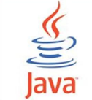
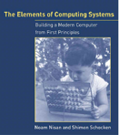


The big picture
JVM
Java
Java compiler
JRE
CLR
C#
C# compiler
.NET base class library
VM
Jack
Jack compiler
Mini OS
7, 8
9
10, 11
12
(Book chapters and Course projects)
Notes:
12

Slide 13
Memory: conceptual / programmer’s view
Memory
Data
Screen memory map
Screen
Keyboard map
Keyboard
Using the memory:
To record or recall values (e.g. variables, objects, arrays), use the first 16K words of the memory
To write to the screen (or read the screen), use the next 8K words of the memory
To read which key is currently pressed, use the next word of the memory.
Notes:
13

Slide 14
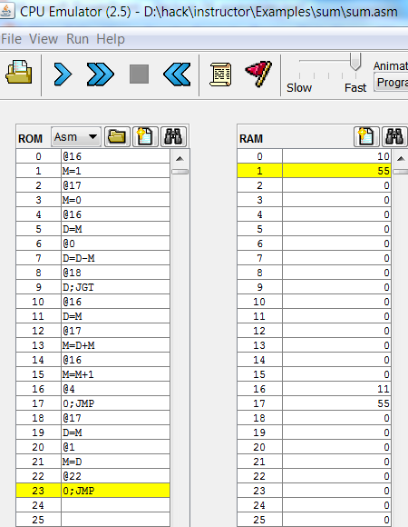
Revisiting Hack low-level programming: an example
Assembly program (sum.asm)
CPU emulator screen shot after running this program
// Computes 1+...+RAM[0]
// And stores the sum in RAM[1].
@i
M=1 // i = 1
@sum
M=0 // sum = 0
(LOOP)
@i // if i>RAM[0] goto WRITE
D=M
@0
D=D-M
@WRITE
D;JGT
@i // sum += i
D=M
@sum
M=D+M
@i // i++
M=M+1
@LOOP // goto LOOP
0;JMP
(WRITE)
@sum
D=M
@1
M=D // RAM[1] = the sum
(END)
@END
0;JMP
user supplied input
program generated output
The CPU emulator allows loading and executing symbolic Hack code. It resolves all the symbolic symbols to memory locations, and executes the code.

Slide 15
The assembler’s view of an assembly program
Assembly program
// Computes 1+...+RAM[0]
// And stores the sum in RAM[1].
@i
M=1 // i = 1
@sum
M=0 // sum = 0
(LOOP)
@i // if i>RAM[0] goto WRITE
D=M
@0
D=D-M
@WRITE
D;JGT
@i // sum += i
D=M
@sum
M=D+M
@i // i++
M=M+1
@LOOP // goto LOOP
0;JMP
(WRITE)
@sum
D=M
@1
M=D // RAM[1] = the sum
(END)
@END
0;JMP
Assembly program = a stream of text lines, each being one of the following:
A-instruction
C-instruction
Symbol declaration: (SYMBOL)
Comment or white space: // comment
The challenge:
Translate the program into a sequence of 16-bit instructions that can be executed by the target hardware platform.
Notes:
15

Slide 16
Compilation models
Two-tier compilation:
First compilation stage: depends only on the details of the source language
Second compilation stage: depends only on the details of the target language.

Slide 17
The big picture
The intermediate code:
The interface between the 2 compilation stages
Must be sufficiently general to support many <high-level language, machine-language> pairs
Can be modeled as the language of an abstract virtual machine (VM)
Can be implemented in several different ways.

Slide 18
Focus of this lecture (yellow):
Some
. . .
. . .
Jack
language
Some Other
Book chapters and
Course projects:
language
language
Some
Jack
9, 10, 11, 12
compiler
Some Other
compiler
compiler
VM language
VM
VM imp.
implementation
VM imp.
VM
over the Hack
7, 8
(this and the next lecture)
over CISC
over RISC
emulator
platform
platforms
platforms
CISC
RISC
. . .
written in
Hack
machine
machine
a high-level
machine
language
language
language
language
. . .
. . .
1, 2, 3, 4, 5, 6
CISC
RISC
other digital platforms, each equipped
Any
Hack
machine
machine
with its VM implementation
computer
computer
Notes:
18

Slide 19
The VM model and language
Perspective:
From here till the end of the next lecture we describe the VM model used in the Hack-Jack platform
Other VM models (like Java’s JVM/JRE and .NET’s IL/CLR) are similar in spirit but differ in scope and details.
Several different ways to think about the notion of a virtual machine:
Abstract software engineering view: the VM is an interesting abstraction that makes sense in its own right
Practical software engineering view: the VM code layer enables “managed code” (e.g. enhanced security)
Pragmatic compiler writing view: a VM architecture makes writing a compiler much easier (as we’ll see later in the course)
Opportunistic empire builder view: a VM architecture allows writing high-level code once and have it run on many target platforms with little or no modification.

Slide 20
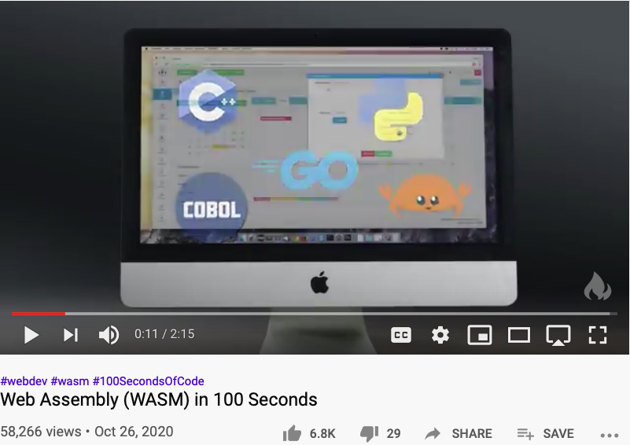
Web Assembly (WASM VM)
Near Naitive Performance, Cross Platform (modern browsers), Lightweight

Slide 21
Yet another view (poetic)
“programmers are creators of universes for which they alone are responsible. Universes of virtually unlimited complexity can be created in the form of computer programs.”
(Joseph Weizenbaum)
Our VM model + language are an example of one such universe.
Notes:
21

Slide 22
Goal: Specify and implement a VM model and language:
Arithmetic / Boolean commands
add
sub
neg
eq
gt
lt
and
or
not
Memory access commands
pop x (pop into x, which is a variable)
push y (y being a variable or a constant)
Program flow commands
label (declaration)
goto (label)
if-goto (label)
Function calling commands
function (declaration)
call (a function)
return (from a function)
This lecture
Next lecture
Our game plan: (a) describe the VM abstraction (above) (b) propose how to implement it over the Hack platform.
Notes:
22

Slide 23
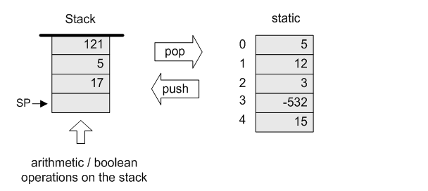
Our VM model is stack-oriented
All operations are done on a stack
Data is saved in several separate memory segments
All the memory segments behave the same
One of the memory segments m is called static, and we will use it (as an arbitrary example) in the following examples:

Slide 24
Data types
Our VM model features a single 16-bit data type that can be used as:
an integer value (16-bit 2’s complement: -32768, ... , 32767)
a Boolean value (0 and -1, standing for true and false)
a pointer (memory address)

Slide 25
Memory access operations
(before)
(after)
The stack:
A classical LIFO data structure
Elegant and powerful
Several hardware / software implementation options.

Slide 26
Evaluation of arithmetic expressions
VM code (example)
// z=(2-x)-(y+5)
push 2
push x
sub
push y
push 5
add
sub
pop z
(suppose that x refers to static 0, y refers to static 1, and z refers to static 2)

Slide 27
Evaluation of Boolean expressions
VM code (example)
// (x<7) or (y=8)
push x
push 7
lt
push y
push 8
eq
or
(suppose that x refers to static 0, and y refers to static 1)
(actually true and false are stored as 0 and -1, respectively)

Slide 28
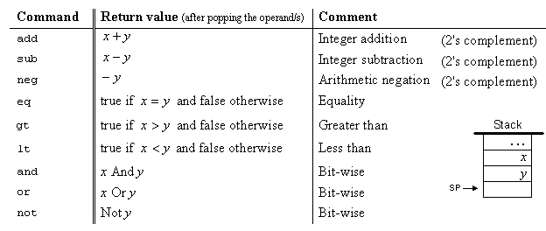
Arithmetic and Boolean commands in the VM language (wrap-up)

Slide 29
The VM’s Memory segments
A VM program is designed to provide an interim abstraction of a program written in some high-level language
Modern OO high-level languages normally feature the following variable kinds:
Class level:
Static variables (class-level variables)
Private variables (aka “object variables” / “fields” / “properties”)
Method level:
Local variables
Argument variables
When translated into the VM language,
The static, private, local and argument variables are mapped by the compiler on the four memory segments static, this, local, argument
In addition, there are four additional memory segments, whose role will be presented later: that, constant, pointer, temp.

Slide 30
Memory segments and memory access commands
The VM abstraction includes 8 separate memory segments named: static, this, local, argument, that, constant, pointer, temp
As far as VM programming commands go, all memory segments look and behave the same
To access a particular segment entry, use the following generic syntax:
Memory access VM commands:
pop memorySegment index
push memorySegment index
Where memorySegment is static, this, local, argument, that, constant, pointer, or temp
And index is a non-negative integer
Notes:
(In all our code examples thus far, memorySegment was static)
The different roles of the eight memory segments will become relevant when we’ll talk about the compiler
At the VM abstraction level, all memory segments are treated the same way.

Slide 31
VM programming
VM programs are normally written by compilers, not by humans
However, compilers are written by humans ...
In order to write or optimize a compiler, it helps to first understand the spirit of the compiler’s target language – the VM language
So, we’ll now see an example of a VM program
The example includes three new VM commands:
function functionSymbol // function declaration
label labelSymbol // label declaration
if-goto labelSymbol // pop x // if x=true, jump to execute the command after labelSymbol // else proceed to execute the next command in the program
For example, to effect if (x > n) goto loop, we can use the following VM commands:
push x
push n
gt
if-goto loop // Note that x, n, and the truth value were removed from the stack.

Slide 32
VM programming (example)
High-level code
VM code (first approx.)
VM code
function mult (x,y) {
int result, j;
result = 0;
j = y;
while ~(j = 0) {
result = result + x;
j = j - 1;
}
return result;
}
function mult(x,y)
push 0
pop result
push y
pop j
label loop
push j
push 0
eq
if-goto end
push result
push x
add
pop result
push j
push 1
sub
pop j
goto loop
label end
push result
return
function mult 2
push constant 0
pop local 0
push argument 1
pop local 1
label loop
push local 1
push constant 0
eq
if-goto end
push local 0
push argument 0
add
pop local 0
push local 1
push constant 1
sub
pop local 1
goto loop
label end
push local 0
return

Slide 33
VM to Assembly (One to Many replacement)
Assembly program
VM code
// Computes 1+...+RAM[0]
// And stores the sum in RAM[1].
@i
M=1 // i = 1
@sum
M=0 // sum = 0
(LOOP)
@i // if i>RAM[0] goto WRITE
D=M
@0
D=D-M
@WRITE
D;JGT
@i // sum += i
D=M
@sum
M=D+M
@i // i++
M=M+1
@LOOP // goto LOOP
0;JMP
(WRITE)
@sum
D=M
@1
M=D // RAM[1] = the sum
(END)
@END
0;JMP
function mult 2
push constant 0
pop local 0
push argument 1
pop local 1
label loop
push local 1
push constant 0
eq
if-goto end
push local 0
push argument 0
add
pop local 0
push local 1
push constant 1
sub
pop local 1
goto loop
label end
push local 0
return
VM code
pop local 0
push argument 1
pop local 1

Slide 34
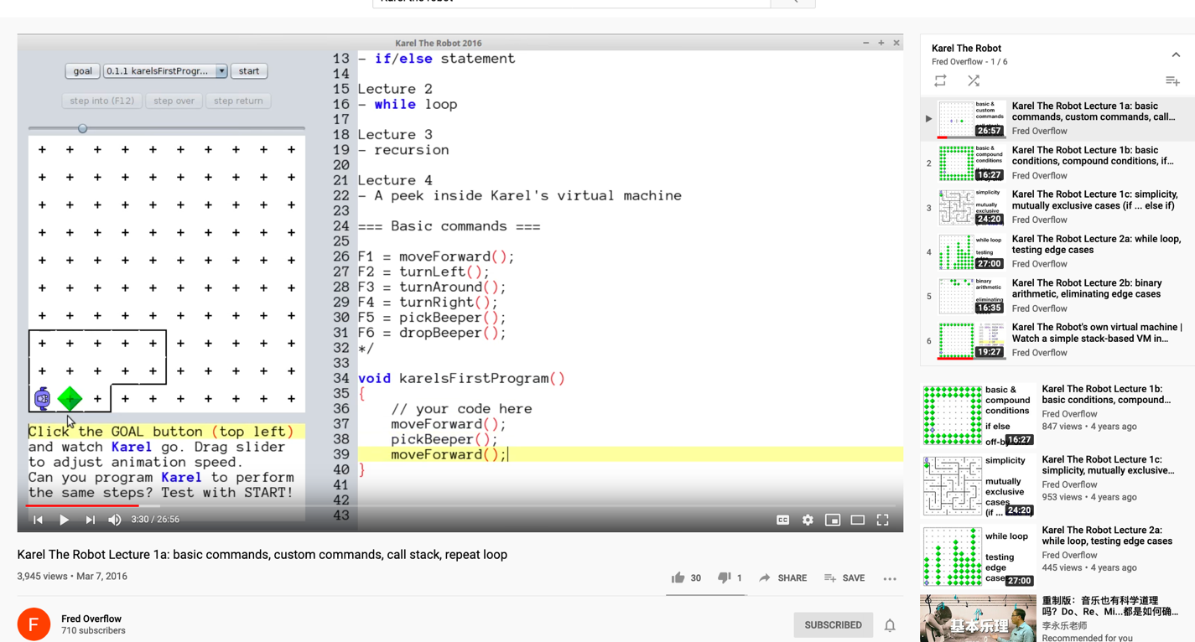
An animated demonstration of how stack-based Virtual Machine works
https://youtu.be/xCnnR6-JApE

Slide 35
VM programming: multiple functions
Compilation:
A Jack application is a set of 1 or more class files (just like .java files).
When we apply the Jack compiler to these files, the compiler creates a set of 1 or more .vm files (just like .class files). Each method in the Jack app is translated into a VM function written in the VM language
Thus, a VM file consists of one or more VM functions.
Execution:
At any given point of time, only one VM function is executing (the “current function”), while 0 or more functions are waiting for it to terminate (the functions up the “calling hierarchy”)
For example, a main function starts running; at some point we may reach the command call factorial, at which point the factorial function starts running; then we may reach the command call mult, at which point the mult function starts running, while both main and factorial are waiting for it to terminate
The stack: a global data structure, used to save and restore the resources (memory segments) of all the VM functions up the calling hierarchy (e.g. main and factorial). The tip of this stack if the working stack of the current function (e.g. mult).
Notes:
35

Slide 36
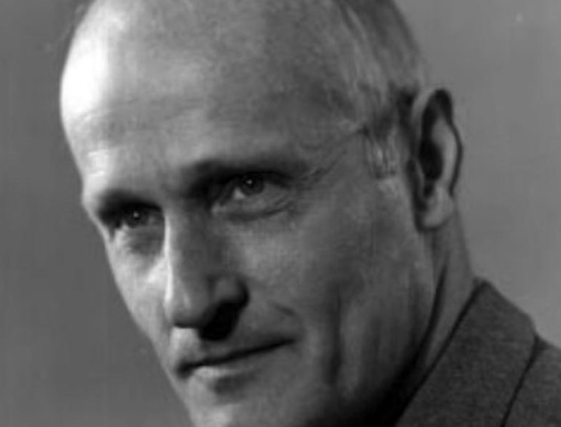
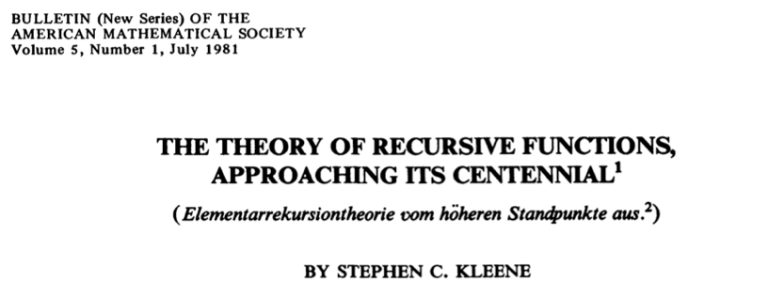
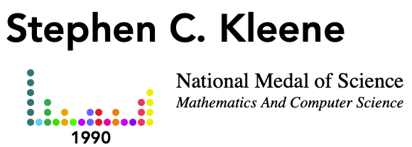
Stephen C. Kleene created Recursive Function Theory
An algorithm is a procedure, given by a finite set of instructions, to serve as follows in relation to a given infinite class of questions, (a) If we select any question from the class, the instructions will tell us how to perform a step, (b) After any step, if we do not receive the answer then, the instructions together with the existing situation will tell us what step to take next, (c) The instructions will enable us to recognize when a situation is reached in which the answer is before us, and to read it off then; and this will eventually happen if the question has an answer. …
For his leadership in the theory of recursion and effective computability and for developing it into a deep and broad field of mathematical research.

Slide 37
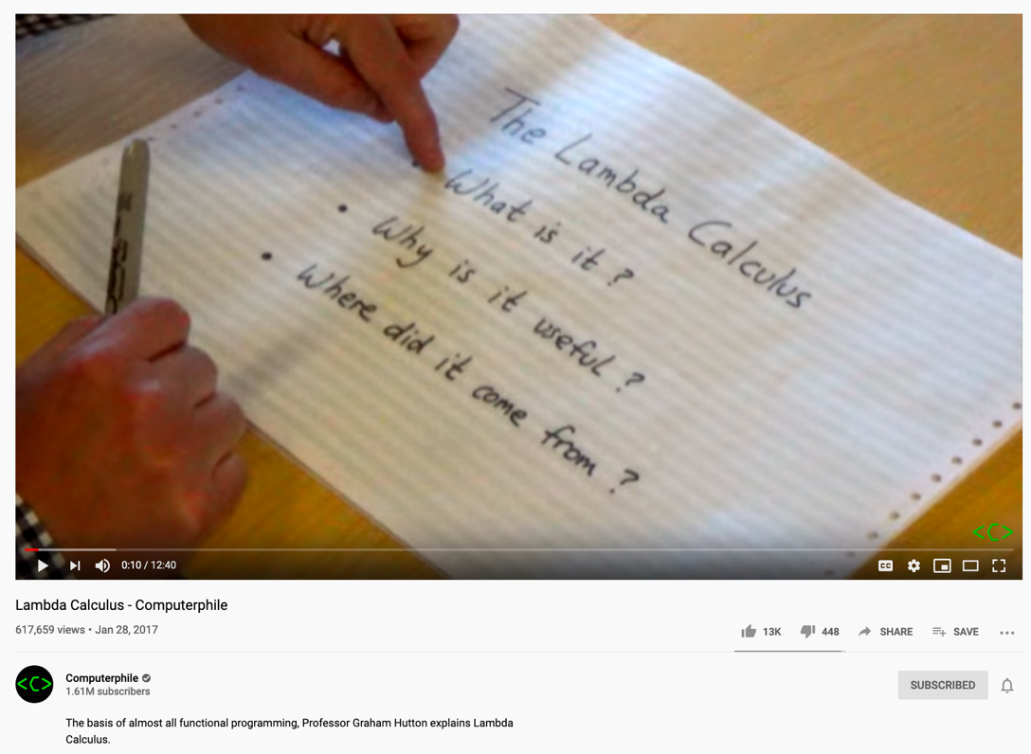
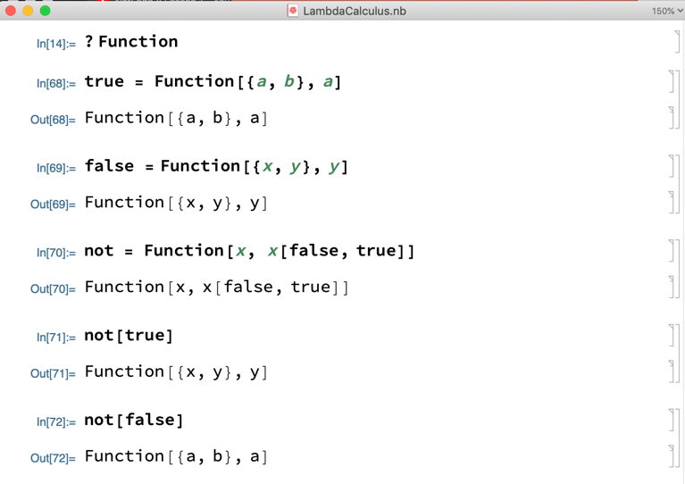
Before Stack-oriented computation, let’s re-examine Lambda Calculus
Notes:
37

Slide 38
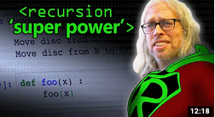
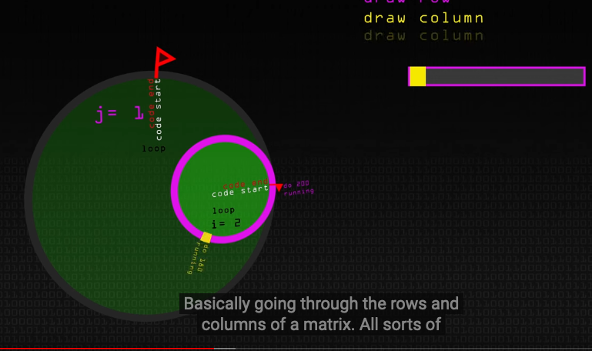
The Magical Power of Recursion
Huawei VP Mr. Yang Shaoqing
Video last viewed: October 26, 2020.
Video last viewed: October 26, 2020.

Slide 39
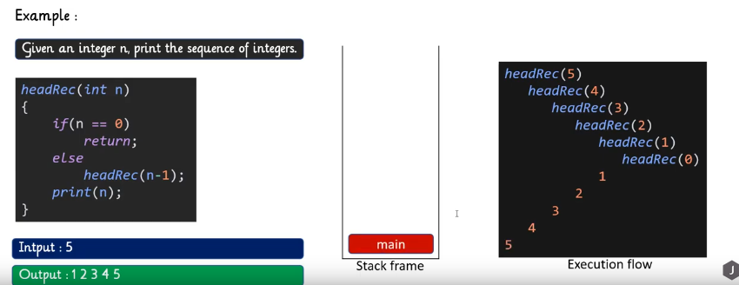
Head Recursion
Huawei VP Mr. Yang Shaoqing
Video last viewed: October 26, 2020.

Slide 40
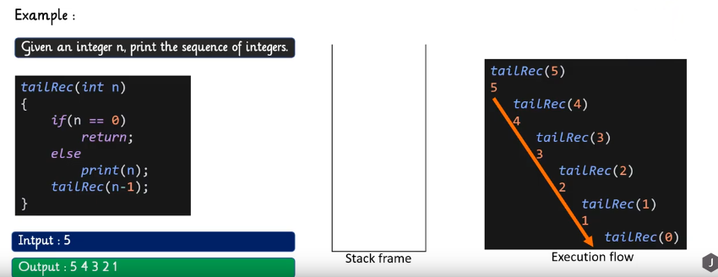
Tail Recursion
Huawei VP Mr. Yang Shaoqing
Video last viewed: October 26, 2020.

Slide 41
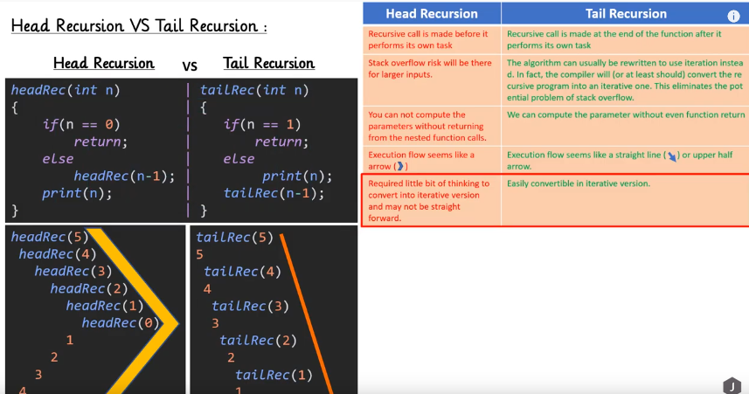
Comparing Head and Tail Recursion
Huawei VP Mr. Yang Shaoqing
Video last viewed: October 26, 2020.

Slide 42
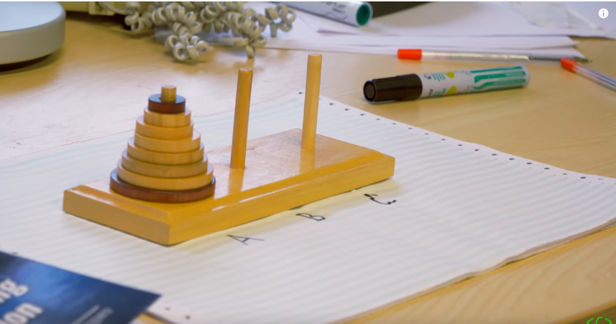
A Typical Example of Recursion
Huawei VP Mr. Yang Shaoqing
Video last viewed: October 26, 2020.

Slide 43
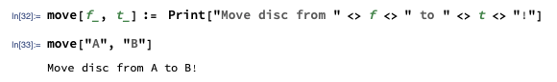
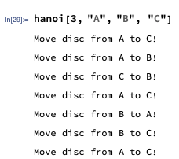
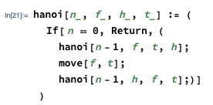
A Sequence of Actions as a Path
Huawei VP Mr. Yang Shaoqing

Slide 44
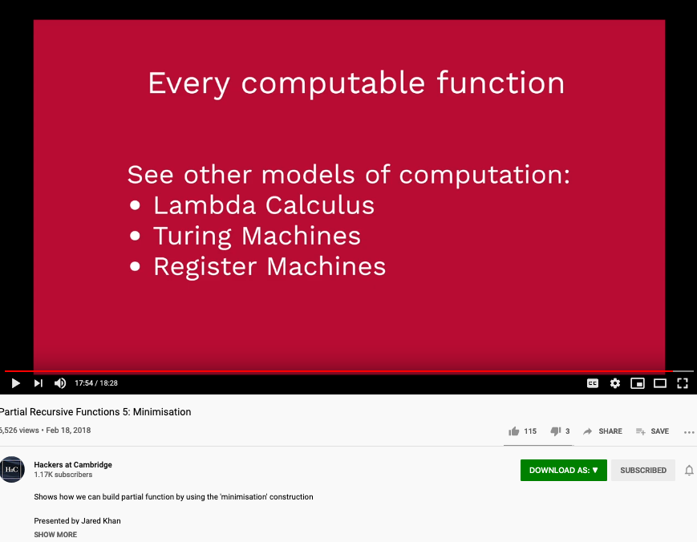
Primitive Recursion’s Universal Power
Huawei VP Mr. Yang Shaoqing
Video last viewed: October 26, 2020.

Slide 45
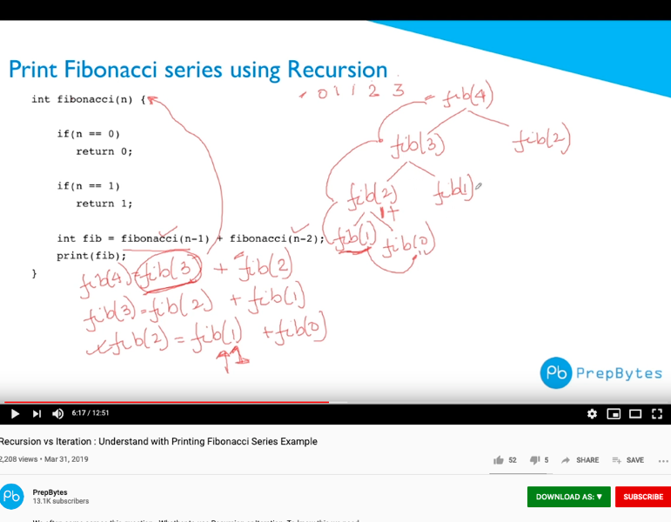
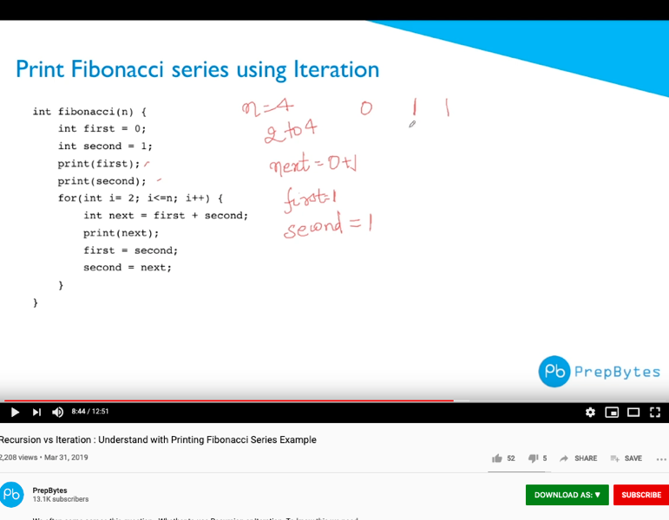
The Choices between Recursion or Iteration?
Huawei VP Mr. Yang Shaoqing
Video last viewed: October 26, 2020.
Video last viewed: October 26, 2020.

Slide 46
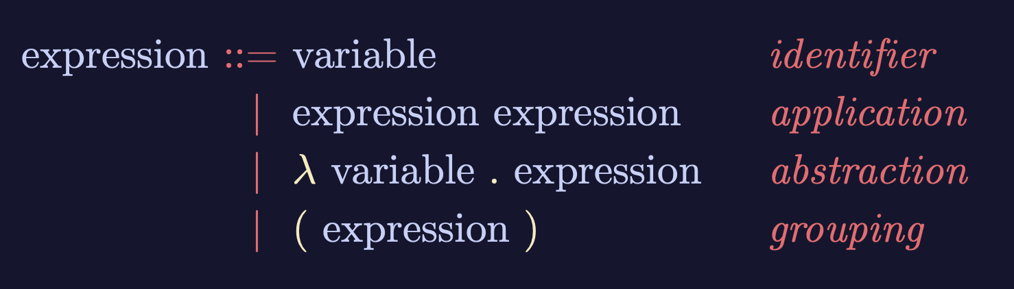
Recursive Structures as a Rewrite System
(Rewrite = Replacement)
Image Source: https://speakerdeck.com/glebec/lambda-calc-talk-frontside-version?slide=66

Slide 47
Monad is an actionable Abstraction
Image Source: https://speakerdeck.com/glebec/lambda-calc-talk-frontside-version?slide=66

Slide 48
Universal set of Replacement Rules
Expression := Variable (* Atomic results, replace nothing *)
| Expression Expression (* Expansive or One-to-Many replacement *)
| 𝜆 Variable Expression (* replace variable content in Expression *)
| ( Expression ) (* Isolate replaceable Expression with boundaries *)
This set of rules can be used recursively to generate an infinite amount of expressions.
Variable
Expression1
Expression2
𝜆
Variable
Expression
( )
Expression

Slide 49
This might look familiar
Expression := Contextualized Data (* Known interpretation results, no computation *)
| Head_Exp Tail_Exp (* Timeless and Time-based expressions *)
| 𝜆 Input Output_Exp(Input) (* A Computing Process *)
| ( Bounded_Exp ) (* Stated boundary conditions/Exceptions *)
This set of rules can be used recursively to generate an infinite amount of expressions.
Contextualized data
Head
Tail
𝜆
Input
Output Spec
( )
Bounded Expression

Slide 50
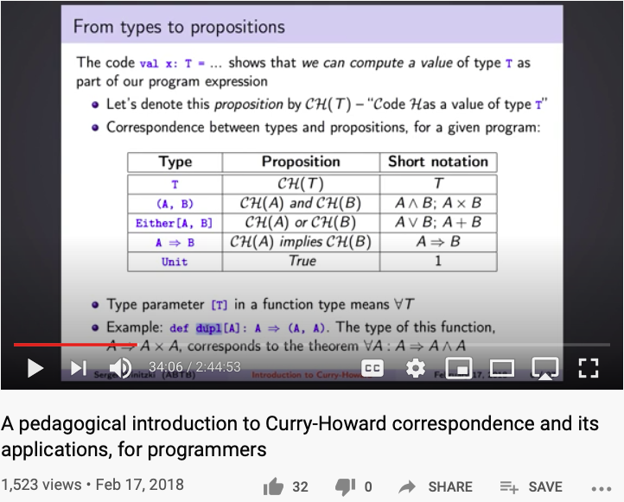
Curry-Howard Correspondence
Last Accessed: October 27, 2020

Slide 51
Goal: Specify and implement a VM model and language:
Arithmetic / Boolean commands
add
sub
neg
eq
gt
lt
and
or
not
Memory access commands
pop x (pop into x, which is a variable)
push y (y being a variable or a constant)
Program flow commands
label (declaration)
goto (label)
if-goto (label)
Function calling commands
function (declaration)
call (a function)
return (from a function)
This lecture
Next lecture
Method: (a) specify the abstraction (stack, memory segments, commands)
(b) propose how to implement the abstraction over the Hack platform.
Notes:
51

Slide 52
Implementation
VM implementation options:
Software-based (e.g. emulate the VM model using Java)
Translator-based (e. g. translate VM programs into the Hack machine language)
Hardware-based (realize the VM model using dedicated memory and registers)
Two well-known translator-based implementations:
JVM: Javac translates Java programs into bytecode; The JVM translates the bytecode into the machine language of the host computer
CLR: C# compiler translates C# programs into IL code; The CLR translated the IL code into the machine language of the host computer.

Slide 53
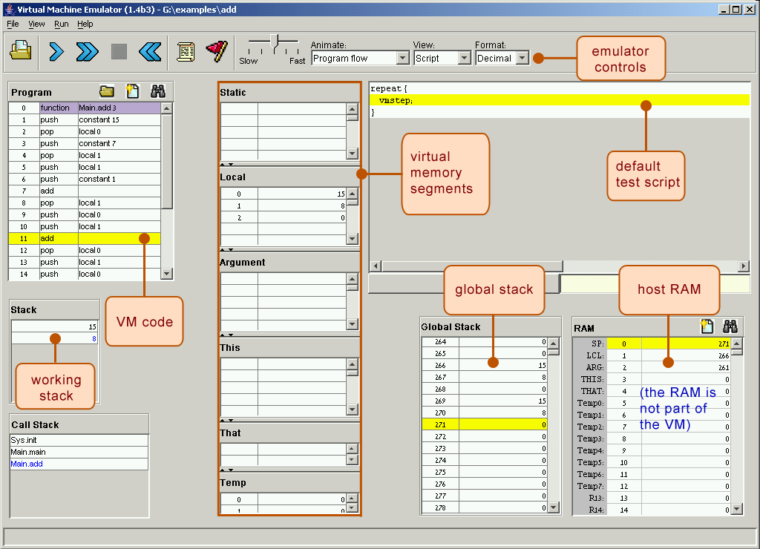
Software implementation: Our VM emulator (part of the course software suite)

Slide 54
VM implementation on the Hack platform
The stack: a global data structure, used to save and restore the resources of all the VM functions up the calling hierarchy.
The tip of this stack if the working stack of the current function
static, constant, temp, pointer: Global memory segments, all functions see the same four segments
local,argument,this,that: these segments are local at the function level; each function sees its own, private copy of each one of these four segments
The challenge: represent all these logical constructs on the same single physical address space -- the host RAM.
Host RAM
Notes:
54

Slide 55
VM implementation on the Hack platform
Basic idea: the mapping of the stack and the global segments on the RAM is easy (fixed); the mapping of the function-level segments is dynamic, using pointers
The stack: mapped on RAM[256 ... 2047]; The stack pointer is kept in RAM address SP
static: mapped on RAM[16 ... 255]; each segment reference static i appearing in a VM file named f is compiled to the assembly language symbol f.i (recall that the assembler further maps such symbols to the RAM, from address 16 onward)
local,argument,this,that: these method-level segments are mapped somewhere from address 2048 onward, in an area called “heap”. The base addresses of these segments are kept in RAM addresses LCL, ARG, THIS, and THAT. Access to the i-th entry of any of these segments is implemented by accessing RAM[segmentBase + i]
constant: a truly a virtual segment: access to constant i is implemented by supplying the constant i.
pointer: discussed later.
Host RAM
Notes:
55

Slide 56
VM implementation on the Hack platform
Practice exercises
Now that we know how the memory segments are mapped on the host RAM, we can write Hack commands that realize the various VM commands. for example, let us write the Hack code that implements the following VM commands:
push constant 1
pop static 7 (suppose it appears in a VM file named f)
push constant 5
add
pop local 2
eq
Tips:
The implementation of any one of these VM commands requires several Hack assembly commands involving pointer arithmetic (using commands like A=M)
If you run out of registers (you have only two ...), you may use R13, R14, and R15.
Host RAM
Notes:
56

Slide 57
Proposed VM translator implementation: Parser module
Parser: Handles the parsing of a single .vm file, and encapsulates access to the input code. It reads VM commands, parses them, and provides convenient access to their components. In addition, it removes all white space and comments.
Routine | Arguments | Returns | Function
Constructor | Input file / stream | -- | Opens the input file/stream and gets ready to parse it.
hasMoreCommands | -- | boolean | Are there more commands in the input?
advance | -- | -- | Reads the next command from the input and makes it the current command. Should be called only if hasMoreCommands is true. Initially there is no current command.
commandType | -- | C_ARITHMETIC, C_PUSH, C_POP, C_LABEL, C_GOTO, C_IF, C_FUNCTION, C_RETURN, C_CALL | Returns the type of the current VM command. C_ARITHMETIC is returned for all the arithmetic commands.
arg1 | -- | string | Returns the first arg. of the current command. In the case of C_ARITHMETIC, the command itself (add, sub, etc.) is returned. Should not be called if the current command is C_RETURN.
arg2 | -- | int | Returns the second argument of the current command. Should be called only if the current command is C_PUSH, C_POP, C_FUNCTION, or C_CALL.

Slide 58
Proposed VM translator implementation: CodeWriter module
CodeWriter: Translates VM commands into Hack assembly code.
Routine | Arguments | Returns | Function
Constructor | Output file / stream | -- | Opens the output file/stream and gets ready to write into it.
setFileName | fileName (string) | -- | Informs the code writer that the translation of a new VM file is started.
writeArithmetic | command (string) | -- | Writes the assembly code that is the translation of the given arithmetic command.
WritePushPop | command (C_PUSH or C_POP), segment (string), index (int) | -- | Writes the assembly code that is the translation of the given command, where command is either C_PUSH or C_POP.
Close | -- | -- | Closes the output file.
Comment: More routines will be added to this module in the next lecture / chapter 8.

Slide 59
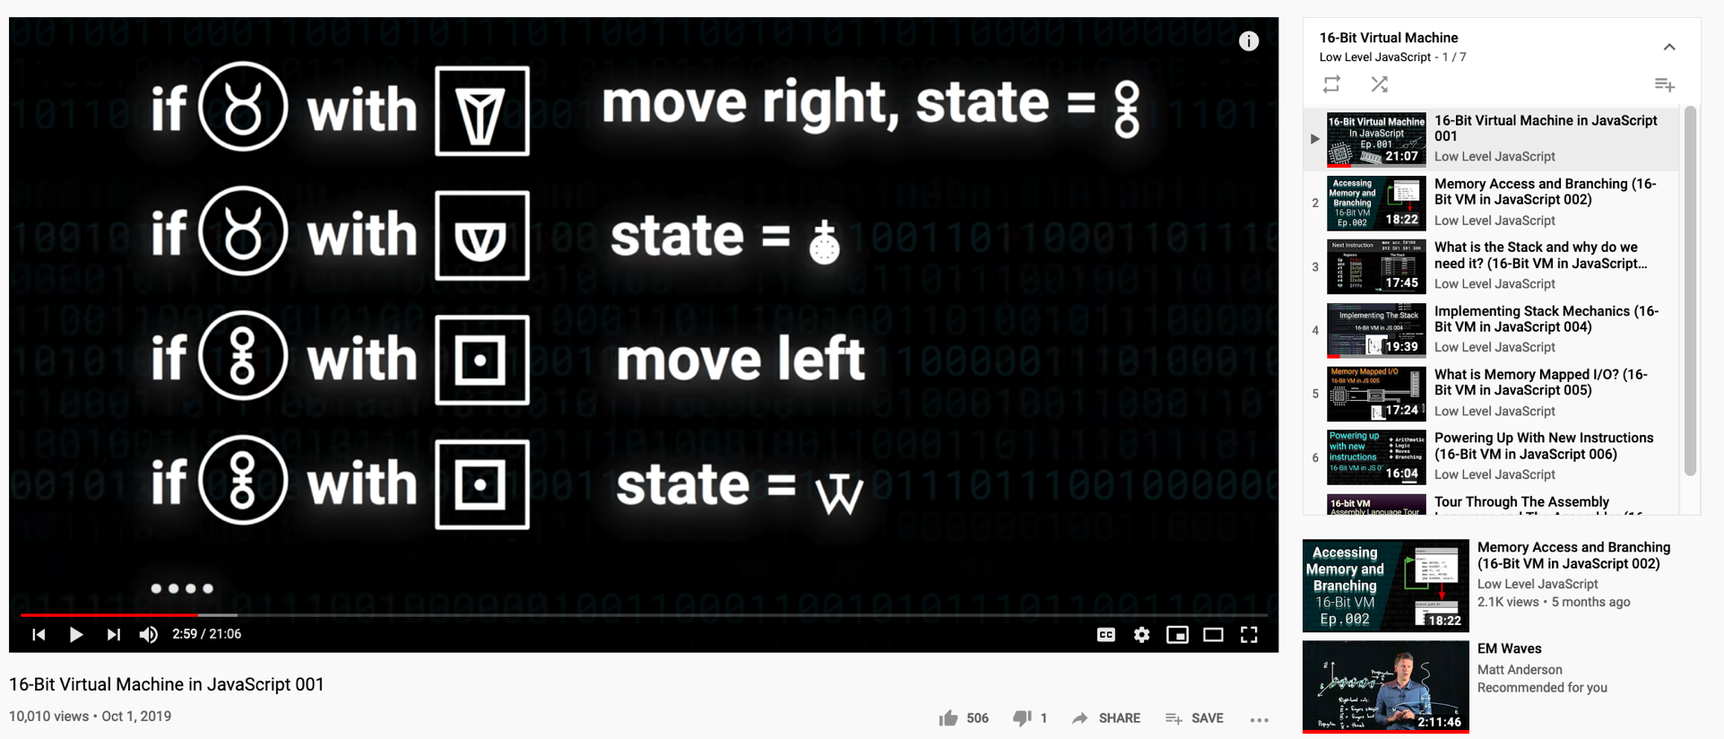
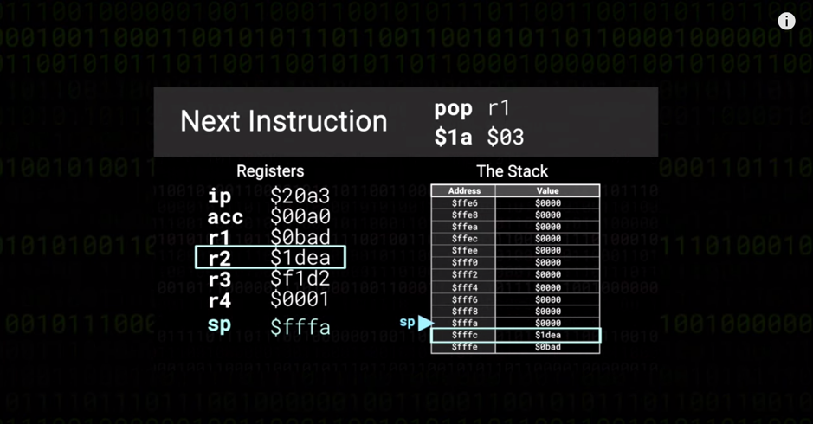
How to build a Virtual Machine using JavaScript (7 episode series)
Eposode 4
https://youtu.be/fTBwD3sb5mw

Slide 60
Perspective
In this lecture we began the process of building a compiler
Modern compiler architecture:
Front-end (translates from a high-level language to a VM language)
Back-end (translates from the VM language to the machine language of some target hardware platform)
Brief history of virtual machines:
1970’s: p-Code
1990’s: Java’s JVM
2000’s: Microsoft .NET
A full blown VM implementation typically also includes a common software library (can be viewed as a mini, portable OS).
We will build such a mini OS later in the course.

Slide 61
Some After Thoughts
Virtual Machine is a Generic Abstraction in terms of Stack-based Machine
The notion of Monad has been invented by early computing scientists
Leibniz thought about Monad, but failed to formulate it as a Stack-based Machine
One can think of Monad in terms of Lambda Calculus
Stack-based Machine can be visualized as Turing Machine’s Tape
A different way to look at computable abstractions
Church-Turing Thesis: All computing procedures can be reduced down to stack-based operations
Thinking of space-time-energy in terms of entropy and arithmetic operations

